Slide 1
Update of PhD Research Effort Jan-April, 2013
Sai Gollapudi
SERL/PASCAL/Advisor:
Venkatesh Choppella, PhD

Slide 2
Self
Background
Academic work
CogSci / Serious Games
Conference Publications
Prasad, G. V., & Ojha, A. (2012, July). Text, Table and Graph--Which is Faster and More Accurate to Understand?. In Technology for Education (T4E), 2012 IEEE Fourth International Conference on (pp. 126-131). IEEE.
(pending) IHCI 2012 – IT or LD
(pending) HCI 2012 – Cropping of video to save bandwidth

Slide 3
PhD work – current situation
Exploratory stage
NOT Identified a specific problem statement yet
Area of interest:
Personalization … PLUS Accessibility (of Web Content) … FOR Education (or Health ? domain )

Slide 4
Personalization

Slide 5
Personalization
Convention
Individualistic
Single profile / person
Application / service / product linked

Slide 6
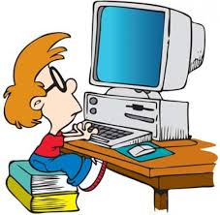
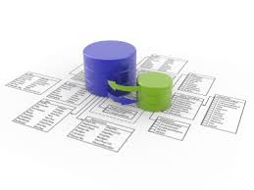
Work that is out there…
Wrapper of Personalization
Enduser
Original Content
Profile Database
Client Side
Server Side
Self reporting
History /cookies
Browser based
Mining
Collaborative Filters
ML
Notes:
http://www.freepik.es/foto-gratis/dekstop-vector-de-la-computadora-26_11-37394.jpg
http://sct.emu.edu.tr/courses/it/ITEC313/userfiles/images/database-integration.jpg

Slide 7
Personalization
Convention
Proposed NEW direction
Individualistic
Single profile / person
Application / service / product linked
Can be group personalization (e.g. culture norms)
One person can have multiple personas
Personalization Vs Contextualization
Persistent beyond
specific applications
Or even devices

Slide 8
Accessibility

Slide 9
Accessibility
Convention
Physically Disabled
As a follow-up (must-do) activity… just to be compliant with law
Mostly about Access

Slide 10
Literature Survey
Definition of Accessibility (motivating the need, linking with law)
Evaluation of Sites
Checking conformance
Metrics, frameworks
Quantizing the issue
Disability oriented
Blind
Domain oriented
Education, Healthcare, Govt sites, Libraries…
Listing Challenges in making sites accessible
Giving techniques, methodologies…

Slide 11
Accessibility
Convention
Proposed NEW direction
Physically Disabled
As a follow-up (must-do) activity… just to be compliant with law
Mostly about Access
About Comprehension
Content out there but not consumable to many
Push Strategy:
about ubiquity, wider audience
Pull Strategy
Social disability (because of language, culture, context)

Slide 12
New understanding of Accessibility
Digital Divide
Second-order evaluation
Universal Usability
Universal Access + User Experience

Slide 13
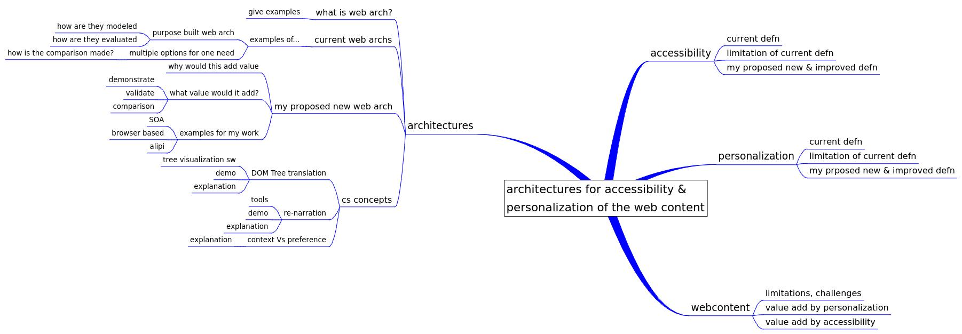
Areas worth exploring (mindmap)

Slide 14
Work done thus far
Exploring literature (informal review)
Development of a MFF browser add-on

Slide 15
Potential scope of work
Browser side development
Service side development
Tool development
Research Scope??

Slide 16
Other areas of Interest
“Digital Resurrection of Swami”

Slide 17
Proposed architecture
Digital Archives
Multiple Media Raw Content
Extraction Tools
Harvesting
Extrusion
Intelligent Agents
Mechanism for Annotate , markup
EndUser
User Interface
INTERNET
Ontology Library
(domain specific)
Presentation Layer
Content Layer
Curator, Admin
Ontology Layer
Editing, mgmt tools

Slide 18
Next Step
Seeking Direction & Guidance
Willing to collaborate
Wanting to finish off the degree quickly so that it does not interfere with my learning & research interests…

Slide 19
Addendum
June, 2013

Slide 20
Research outline 1/2
Indian Students are not on par with the popularized western notion of computer literate, twitch-speed digital native students.
T4E 2012 paper
Indian students have learnt are learning IT by watching others demonstrate usage to them. W/o great awareness of basics, they are users and consumers of the net and the web. Let us not mistake their ease of usage of Youtube and FB to mean computer savvy ness.
T4E 2013 paper (to be submitted)
Indian Students are in fact having (cognitive problems) with current web content
Second potential T4E 2013 paper (VNRVJIET students)

Slide 21
Research outline 2/2
As it is unreasonable to assume that we have to create new content or abandon existing content, we now have to rely on renarration, accessibility, personalization type solutions.
Theory thru literature survey (ongoing)
Theory behind these items
I am exploring the value of few architectures that enable these.
Browser add-on as a personalization option
SaiGo done
Alipi – enhancement (providing another way to turn in Sweets)
To be designed; how about IDH for voice?
Web Services for personalization
VNRVJIET – team #2
Namespace overloading
VNRVJIET – team #3
I demonstrate the value generated by these methods.
???

